Slide 1
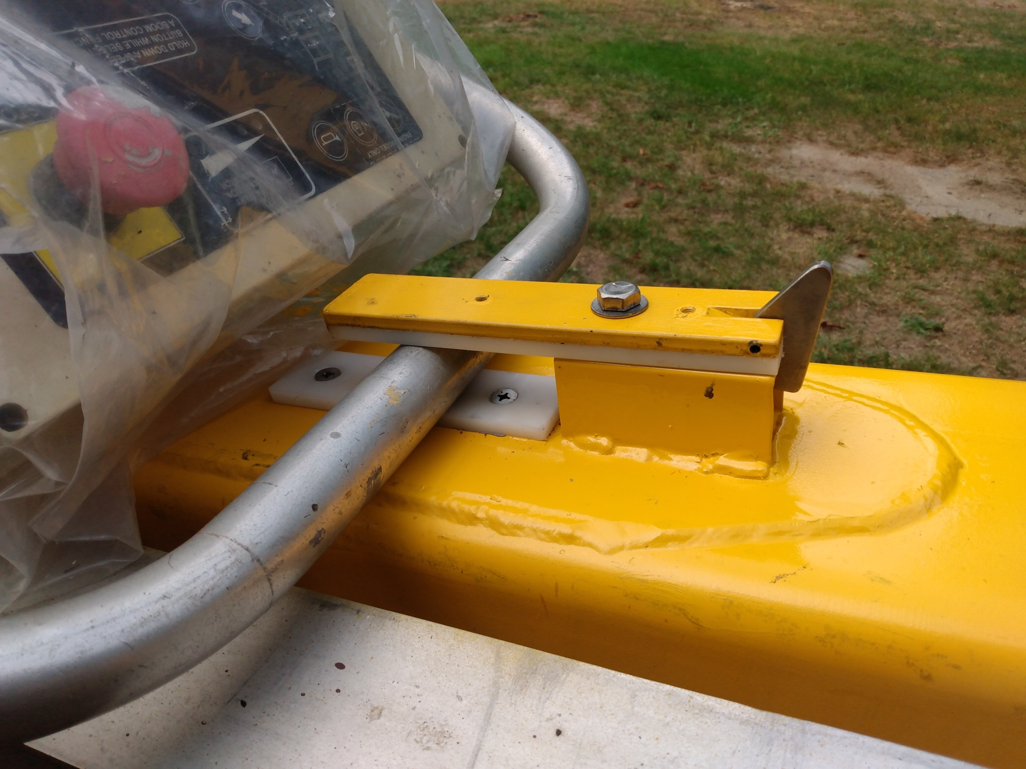
Improved latch for basket
If you forget to unlatch the basket it will just slide out

Slide 2
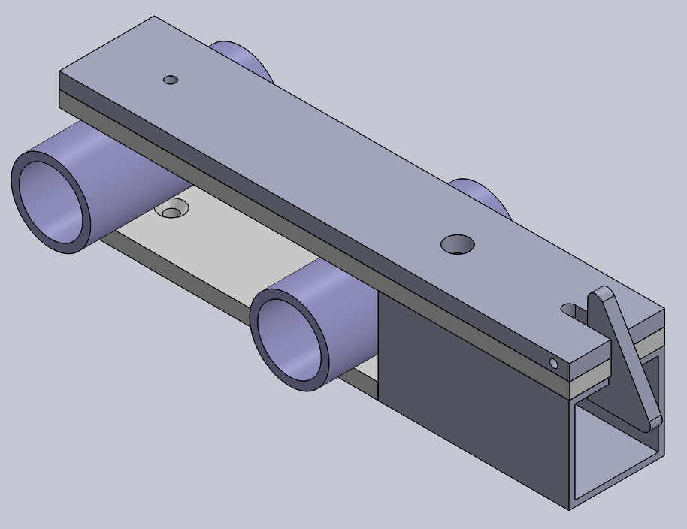
Steel Bar
Stainless Steel Latch
Possible range of railing
depending on basket tilt
Nylon pads

Slide 3
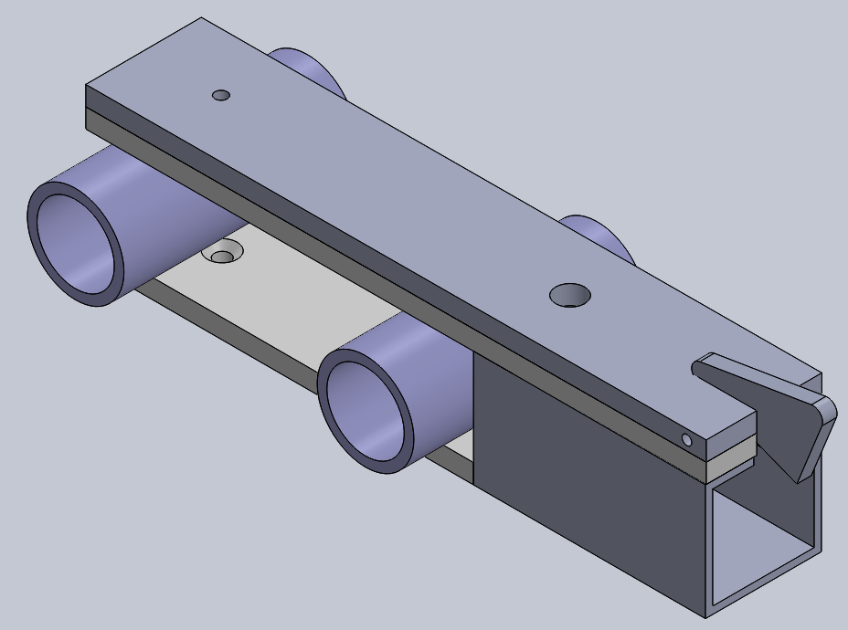
Latch pushed forward

Slide 4
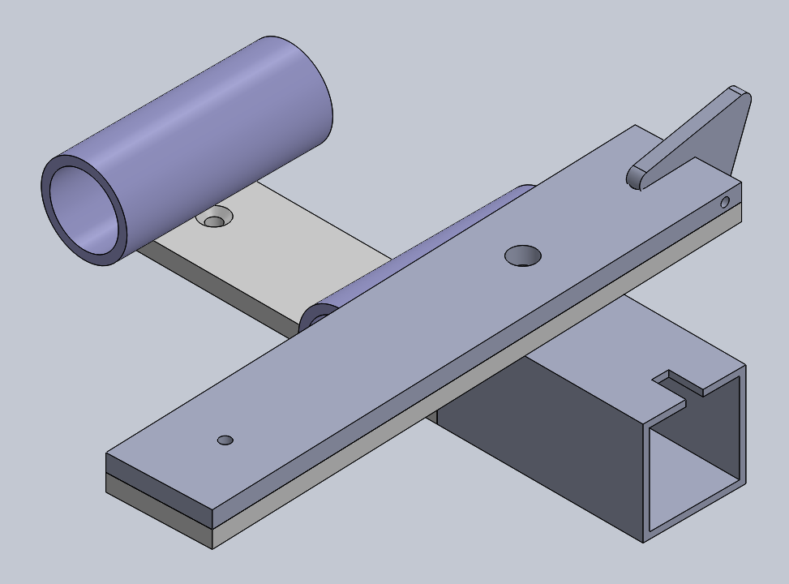
Bar rotated
Basket rail is now free to rise

